Slide 1
Advanced Topics
Ishrat Jahan

Slide 2
Load Balancing

Slide 3
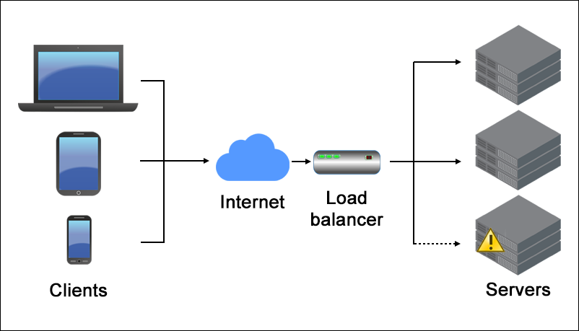
Load Balancing

Slide 4
High Availability

Slide 5
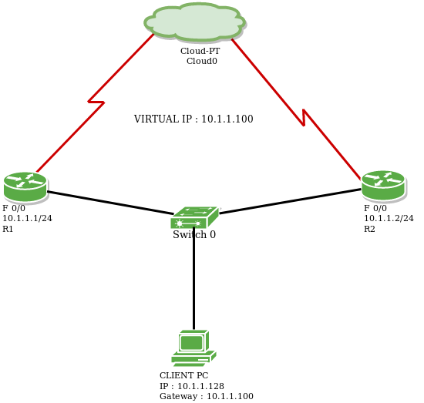
VRRP - Virtual Router Redundancy Protocol

Slide 6
SDN (Software Defined Networking)

Slide 7
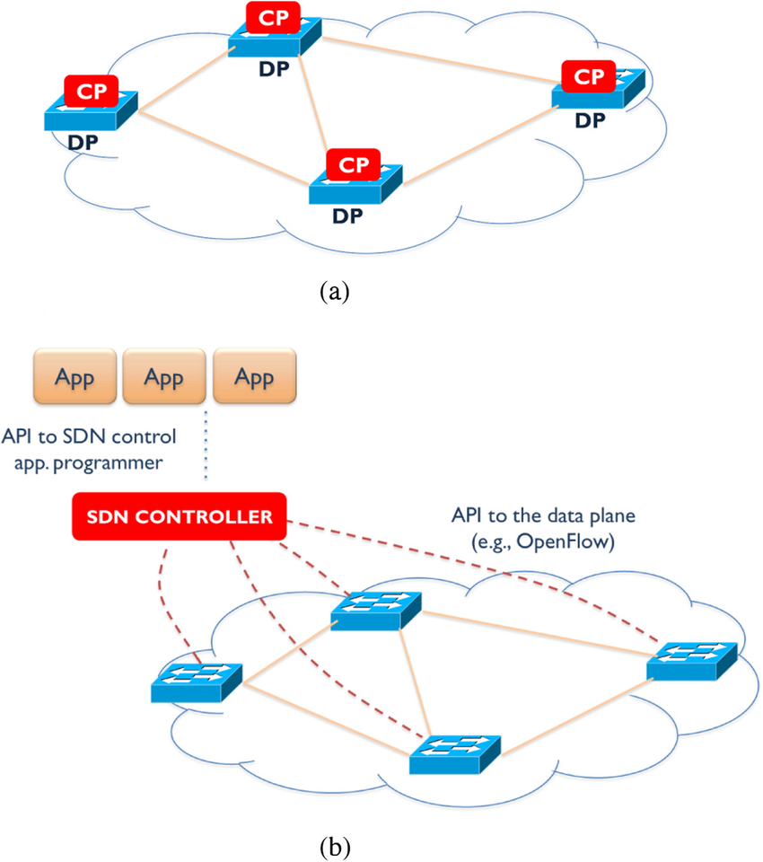
CP - Control Plane DP - Data Plane
Traditional networking
SDN

Slide 8
Network Virtualization

Slide 9
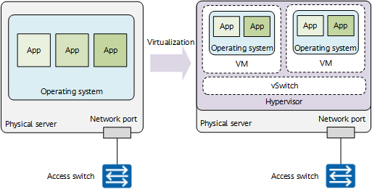
Server Virtualization

Slide 10
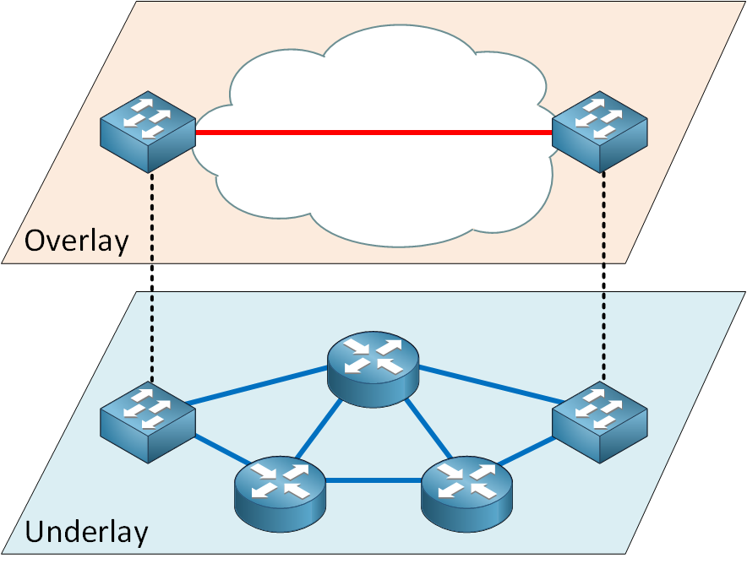
Network Virtualization (Overlay vs Underlay)

Slide 11
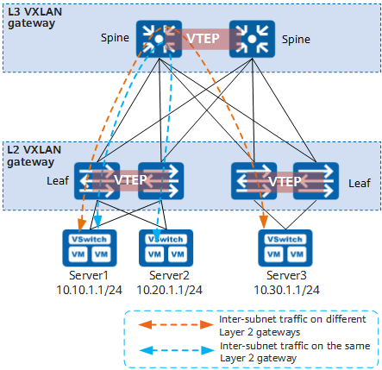
VXLAN
For details, please check this website.

